Slide 1
Intrusion detection system
Group 16
Group Members guide
T Srichakranath 19241a1255 Dr. N. Rajasekhar
Shaik Sohel 19241a1251 Professor, IT,GRIET
P Venkata Anirudh 19241a1238
P Hruthvik Reddy 19241a1240

Slide 2
abstract

Slide 3
More personal information and important data are in the computers now more than ever. So, it is important that there is a strong security to keep data from being stolen and misused. An Intrusion detection system (IDS) is used to detect if there are any intrusions that happen in a system and notify the administrator if there are any. In IDS reports malicious activities or policy violations to the admin through a system called security information and event management system. Multiple support systems are used to generate the log information and an SIEM combines this information and then is used to raise alarms. These alarms can sometimes become false alarms. Support all major communication formats plus internet & StarLink Wireless Radios, universal primary/backup. Network Intrusion detection systems are fixed at strategic locations in the network which have high possibilities of detecting an attack. Once an attack is identified the admin of the system is notified by raising an alert. An analysis is done on the packet information by checking their signatures with the known attacks in the library. The primary task is to create an application which can effectively detect intrusions and differentiate actual intrusions from false alarms, notify the admin

Slide 4
Design

Slide 5
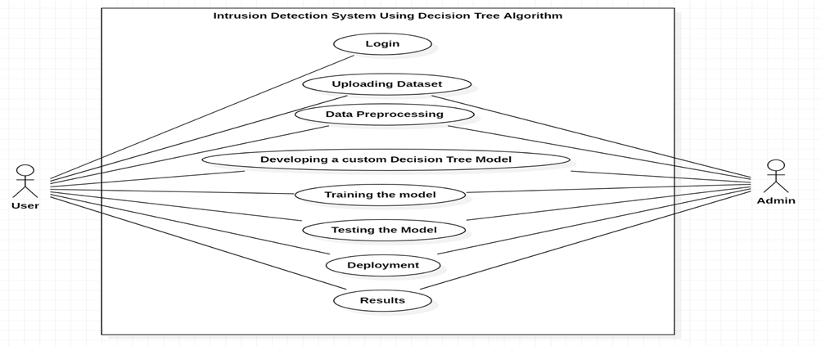
Use case diagram

Slide 6
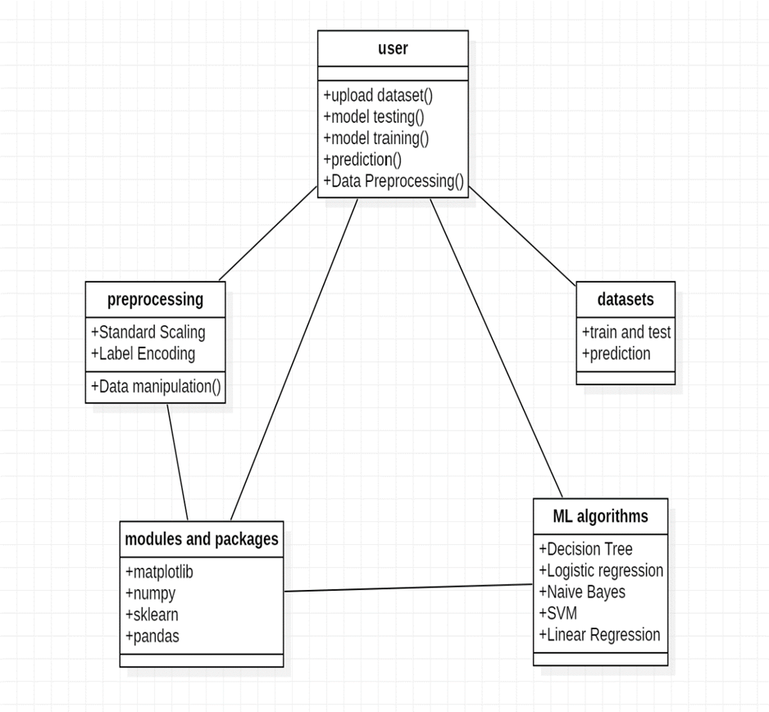
Class diagram

Slide 7
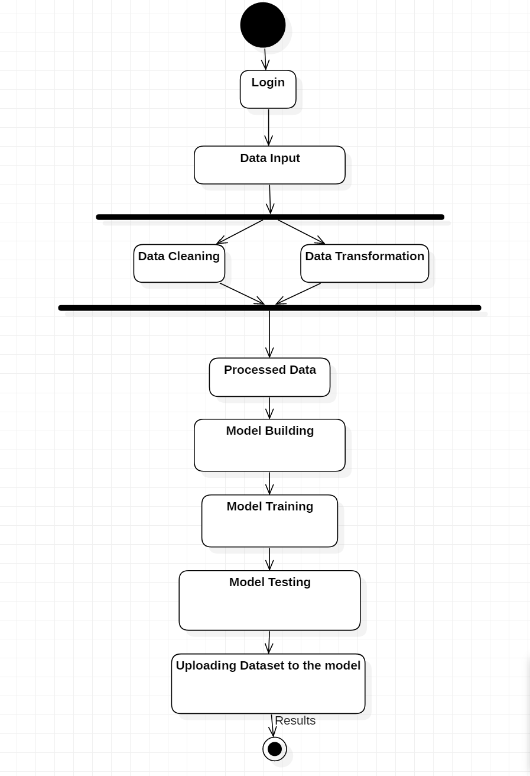
Activity diagram

Slide 8
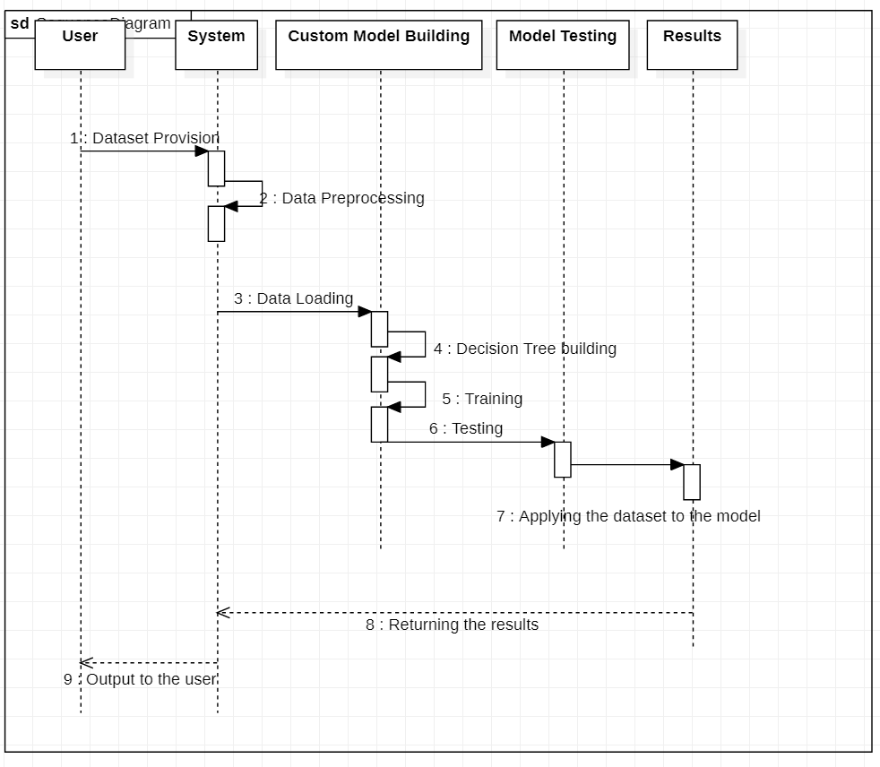
Sequence diagram

Slide 9
execution

Slide 10
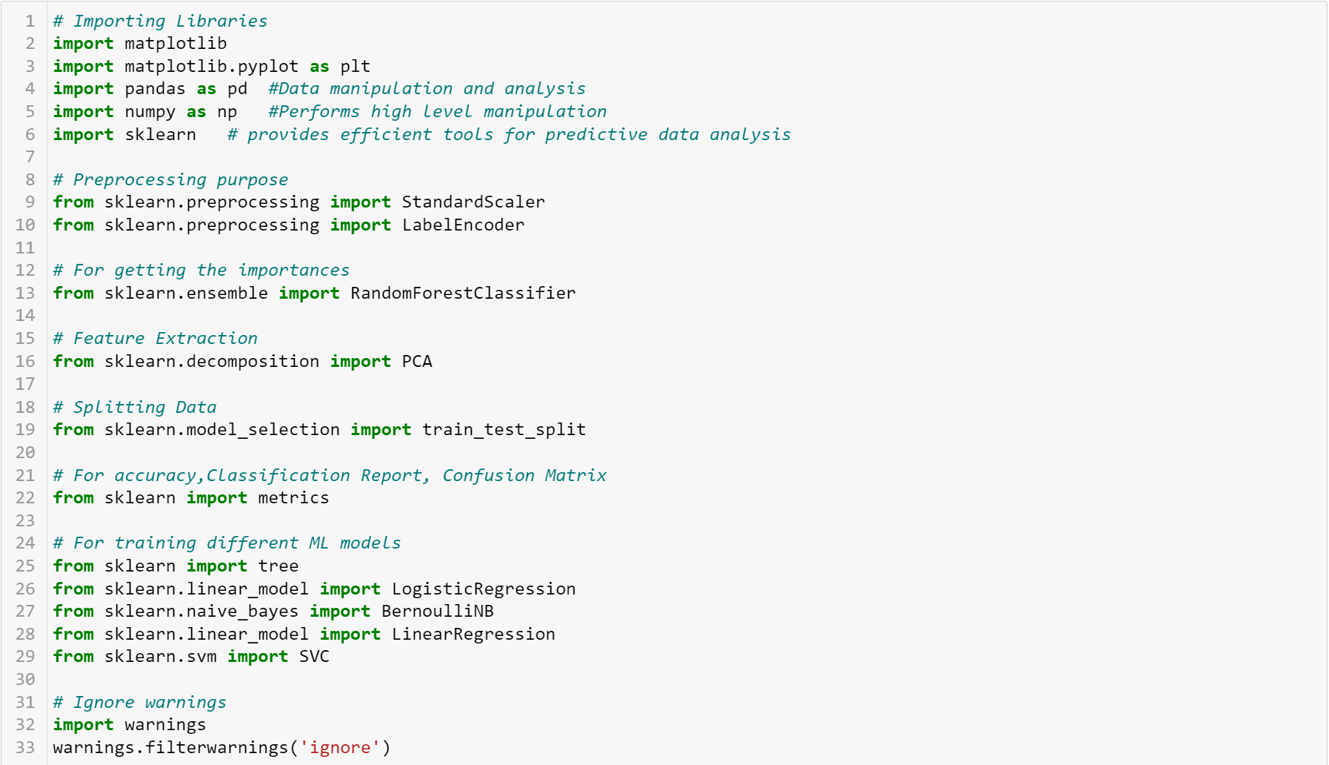
Importing libraries

Slide 11
Loading datasets

Slide 12
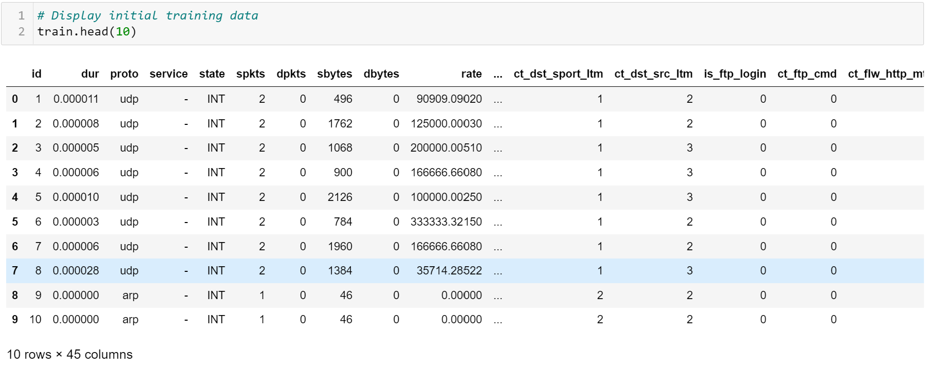
Displaying initial data

Slide 13
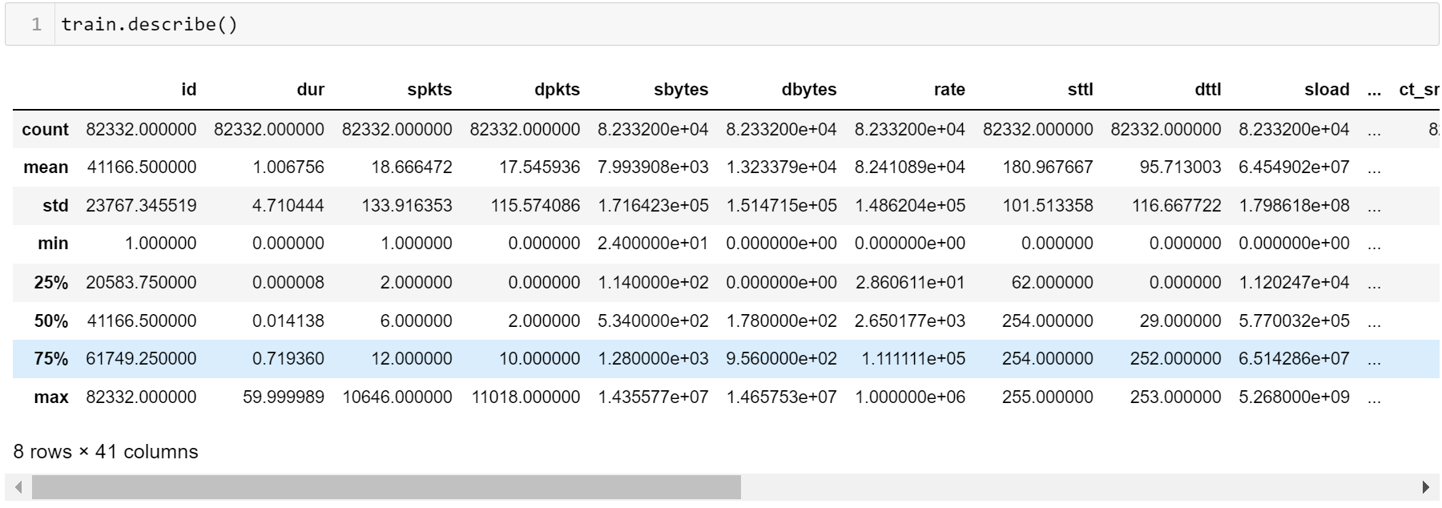
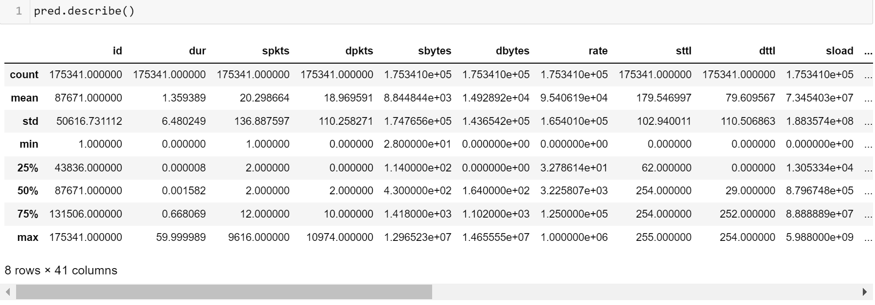
Describing training and prediction data
Training data
Prediction data

Slide 14
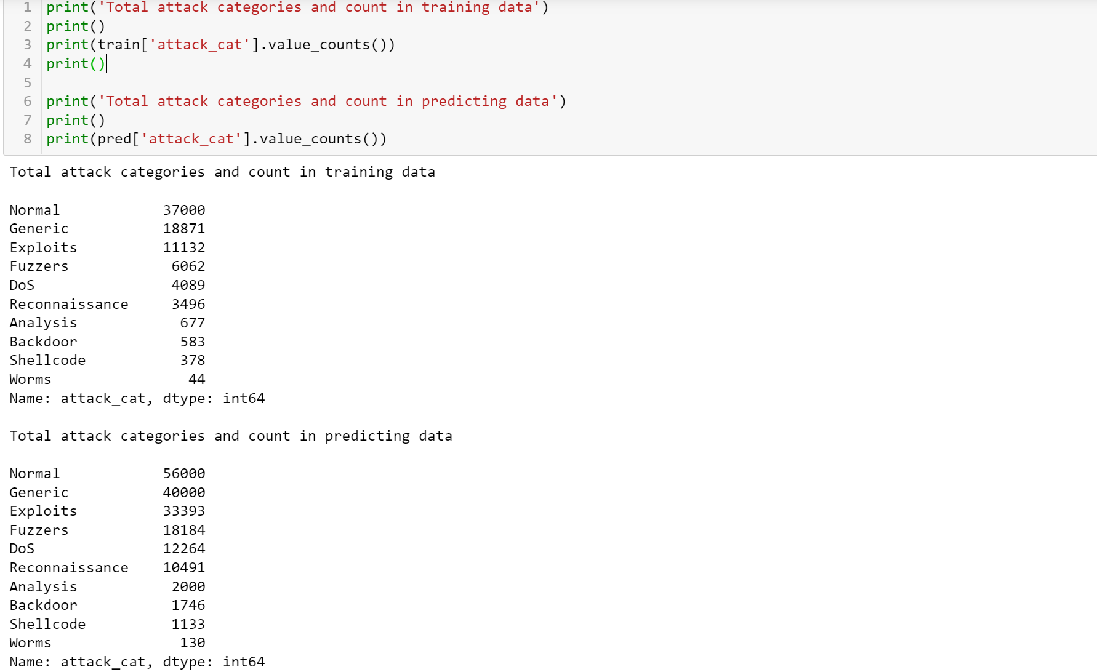
Attack categories in training and prediction

Slide 15
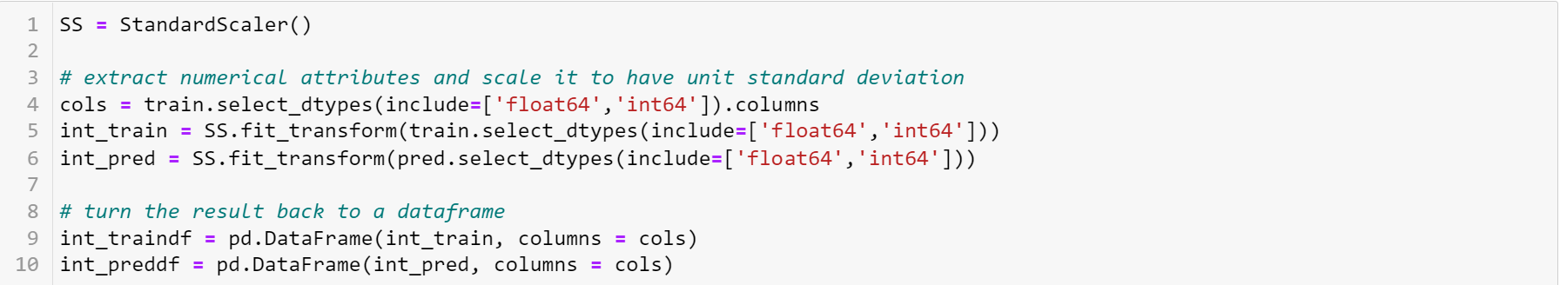
Pre processing – standard scaling

Slide 16
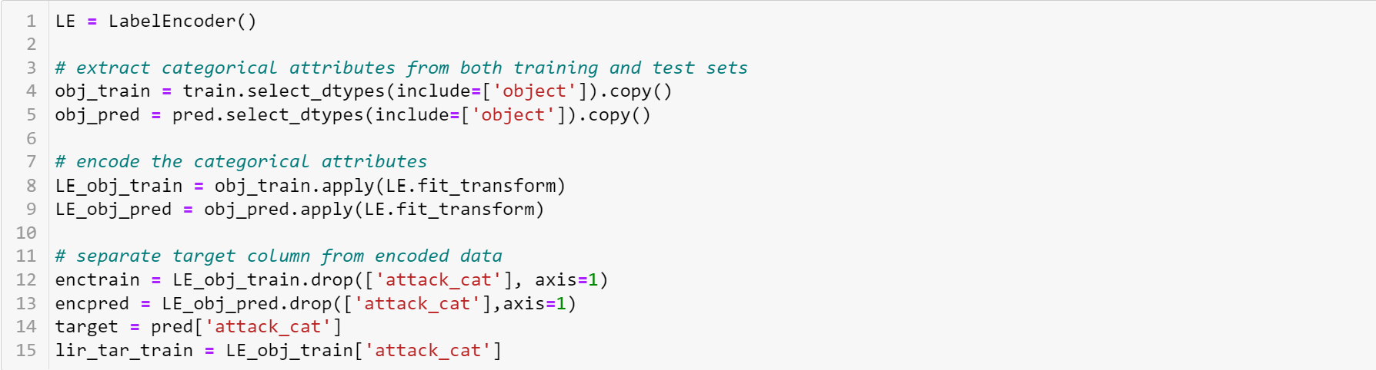
Pre processing – label encoding

Slide 17
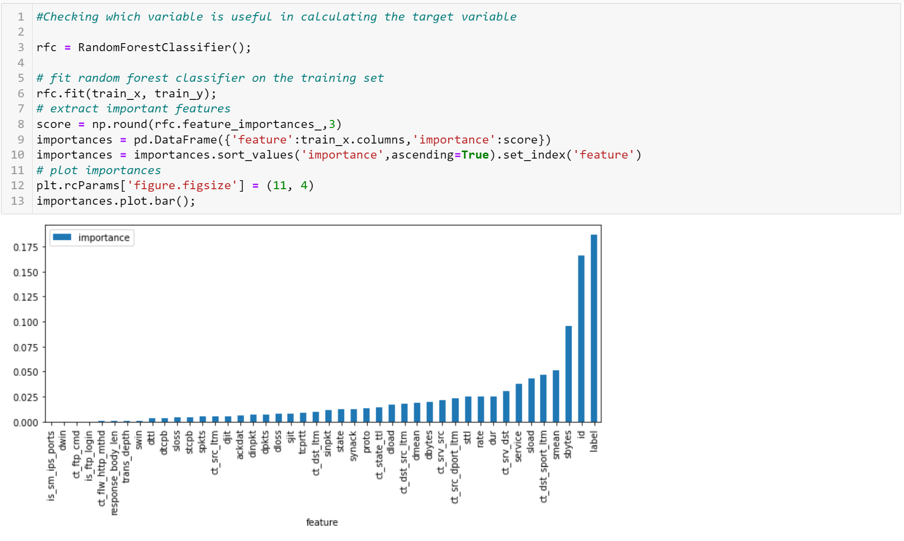
Plotting important factors

Slide 18
Splitting data for training & testing

Slide 19
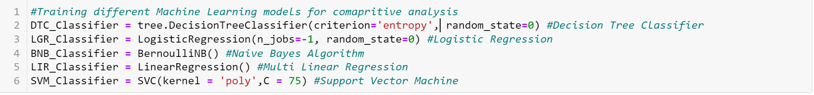
Creating model instances

Slide 20
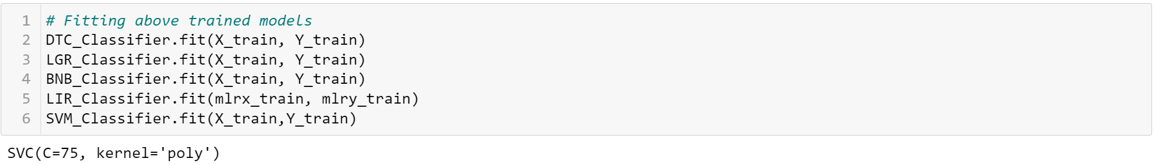
Fitting the models

Slide 21
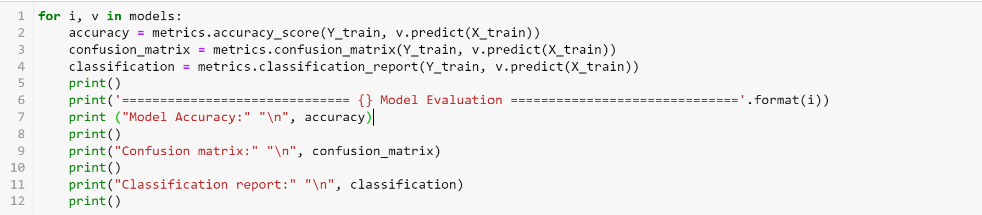
Code for accuracy, classification report, confusion matrix

Slide 22
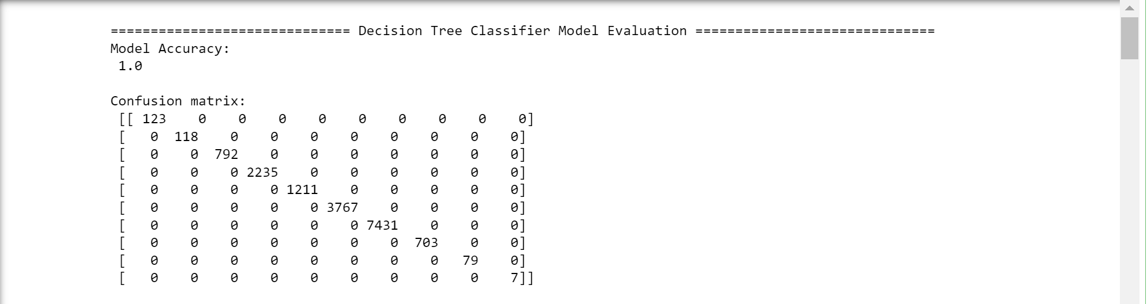
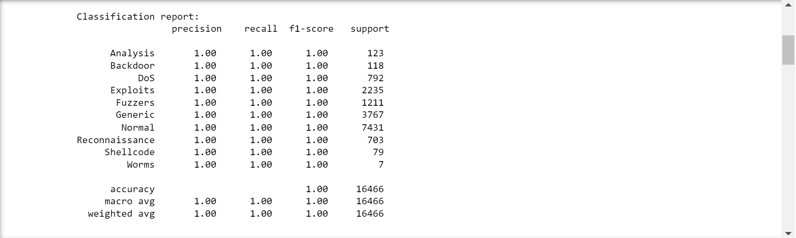
Decision tree

Slide 23
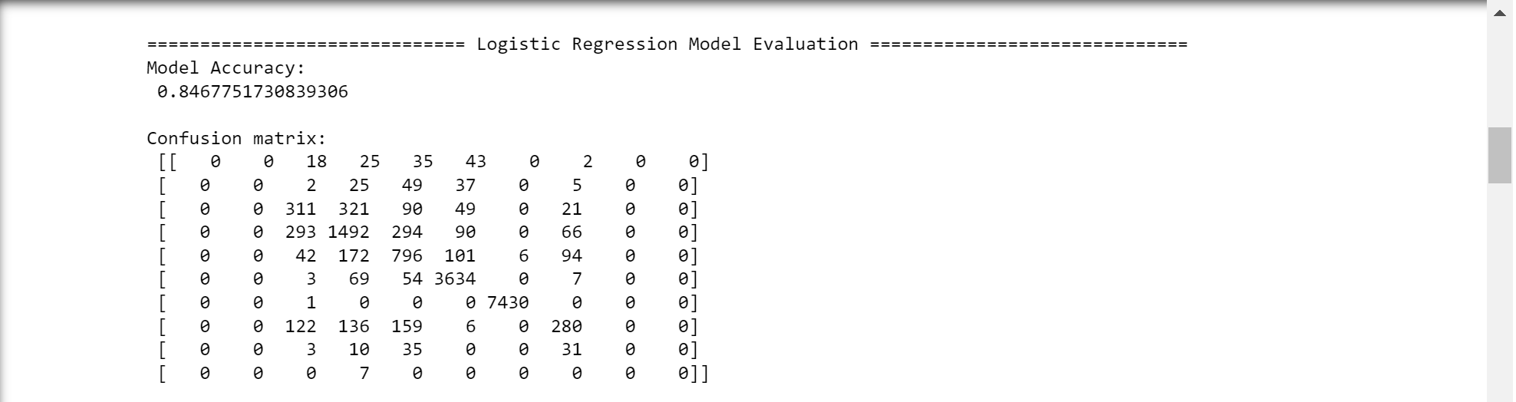
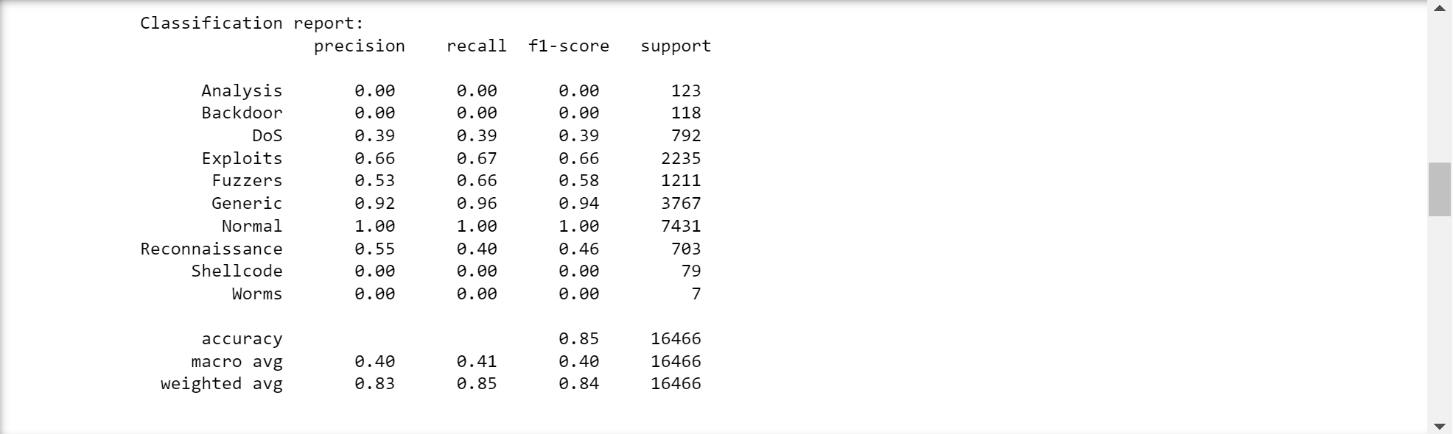
Logistic regression

Slide 24
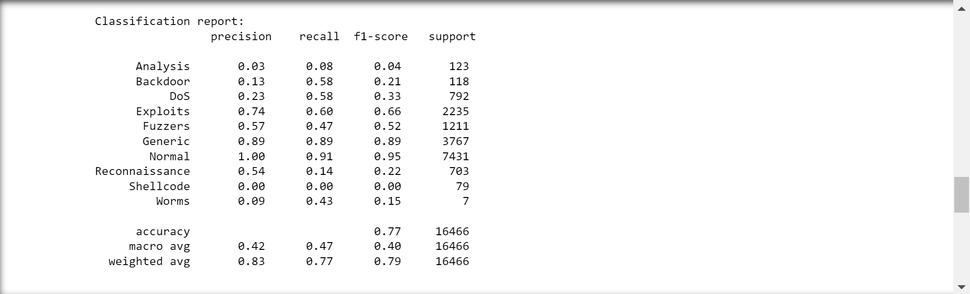
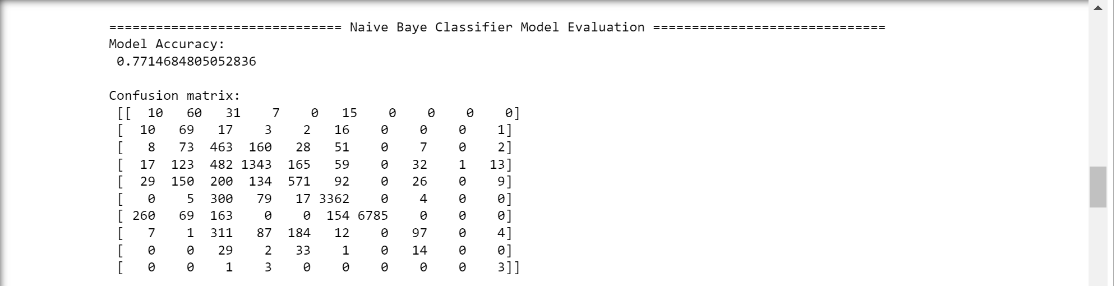
Naïve bayes

Slide 25
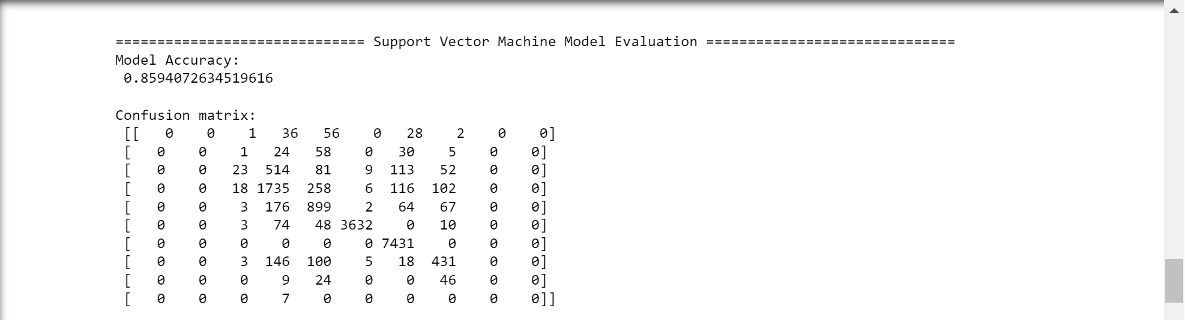
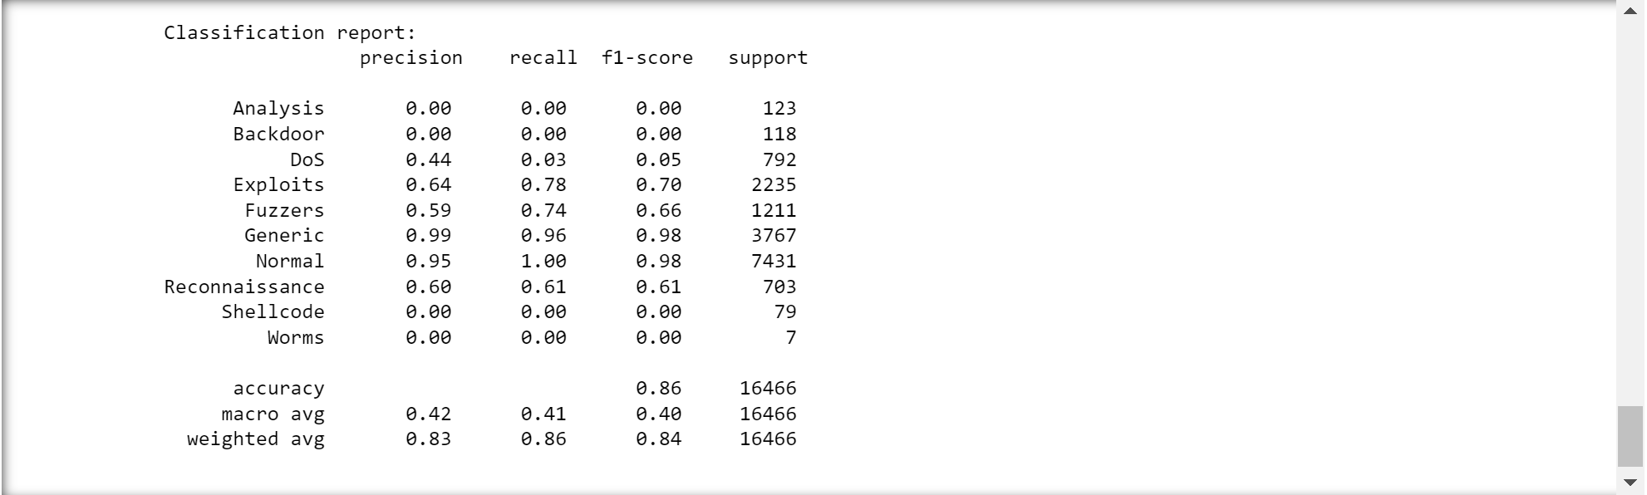
Support vector machine

Slide 26
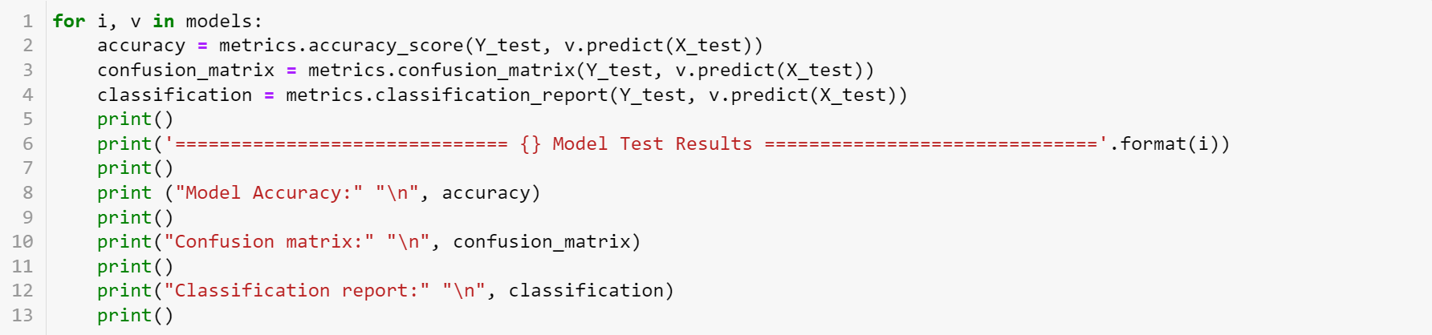
Testing code

Slide 27
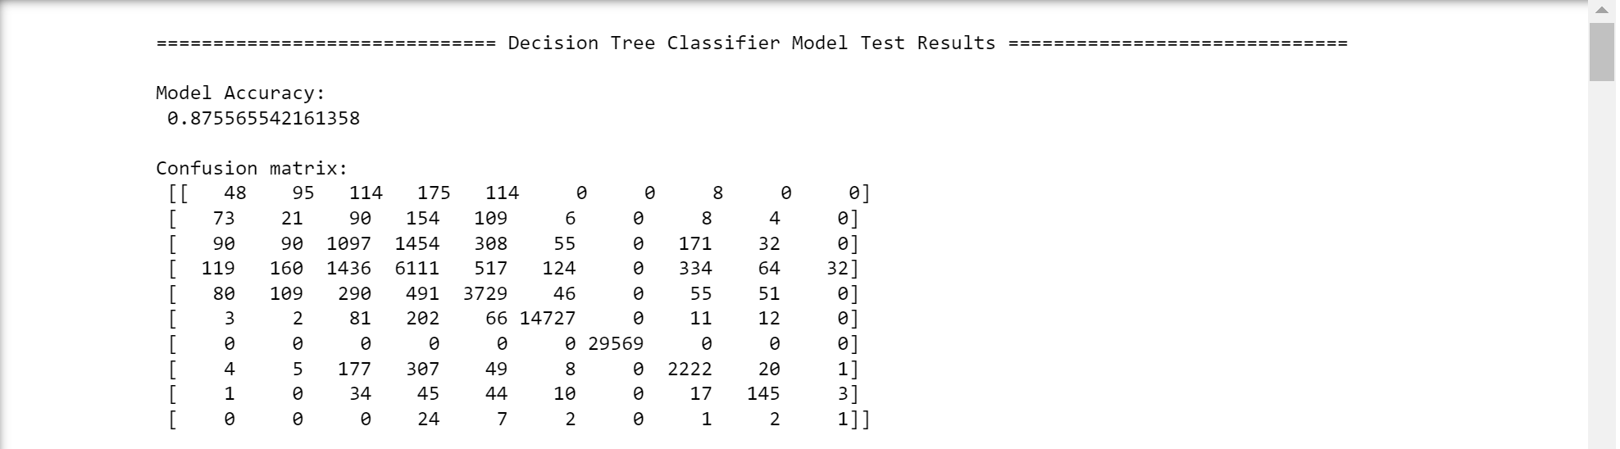
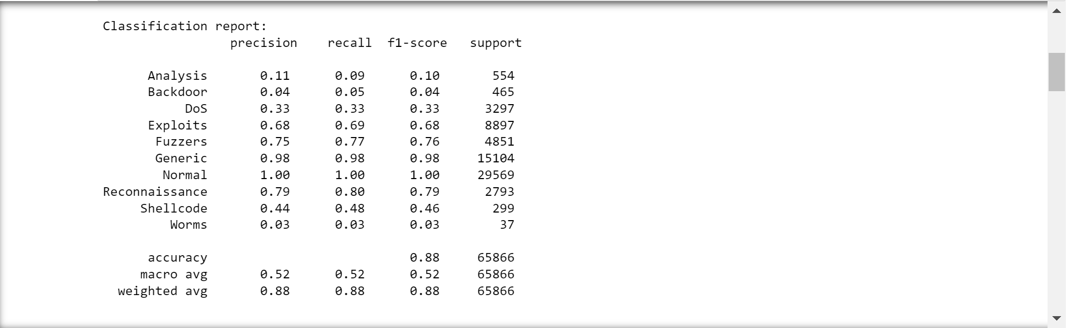
Decision tree

Slide 28
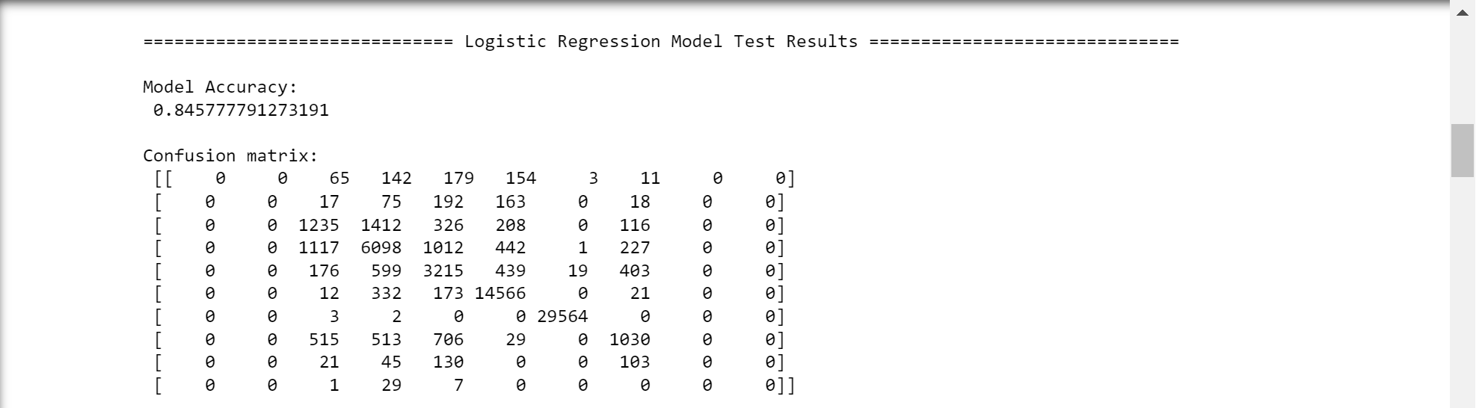
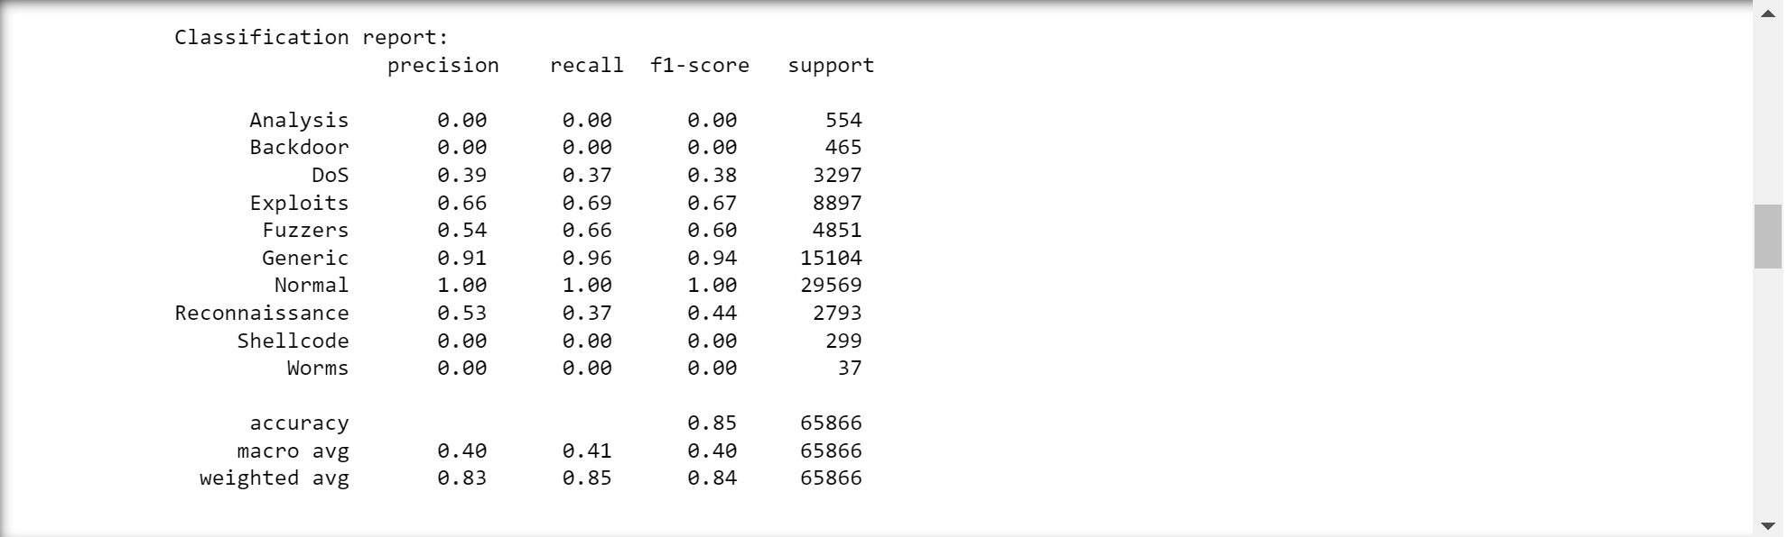
Logistic regression

Slide 29
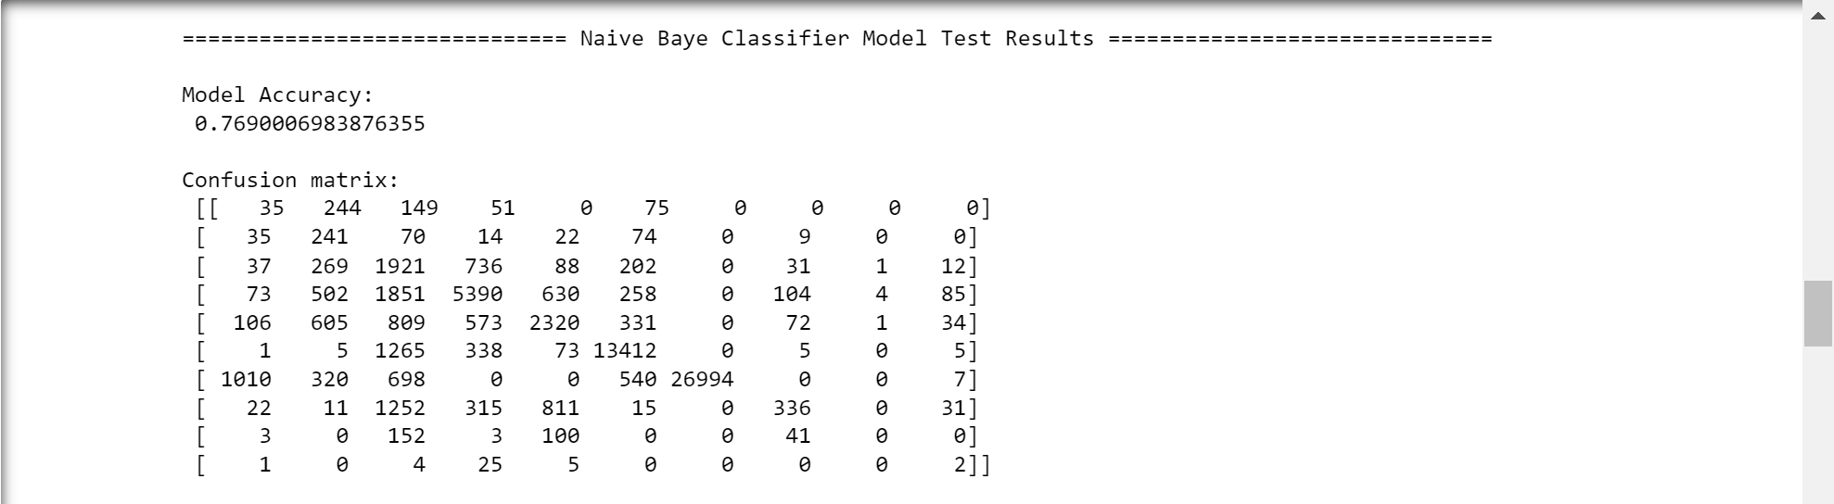
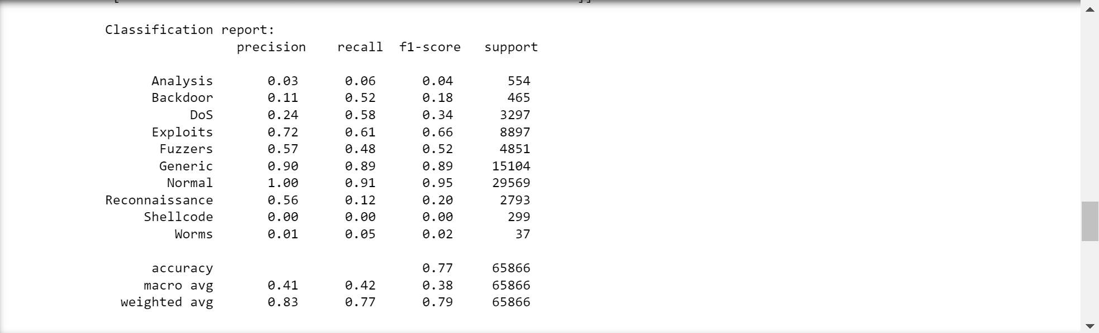
Naïve bayes

Slide 30
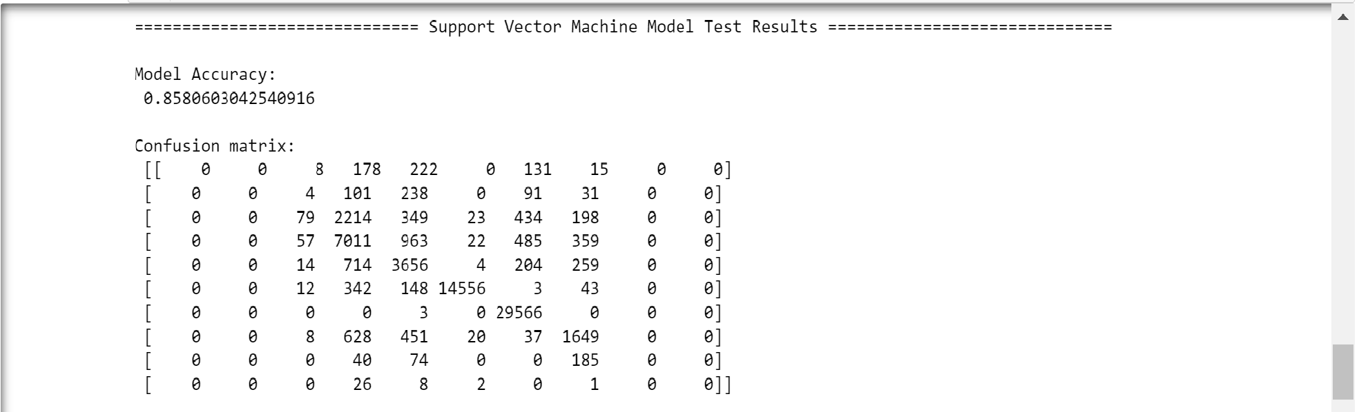

Support vector machine

Slide 31
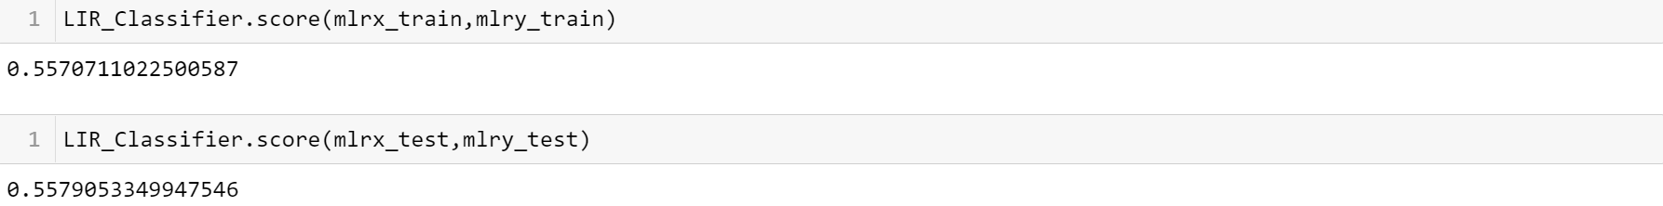
Multi linear regression scores

Slide 32
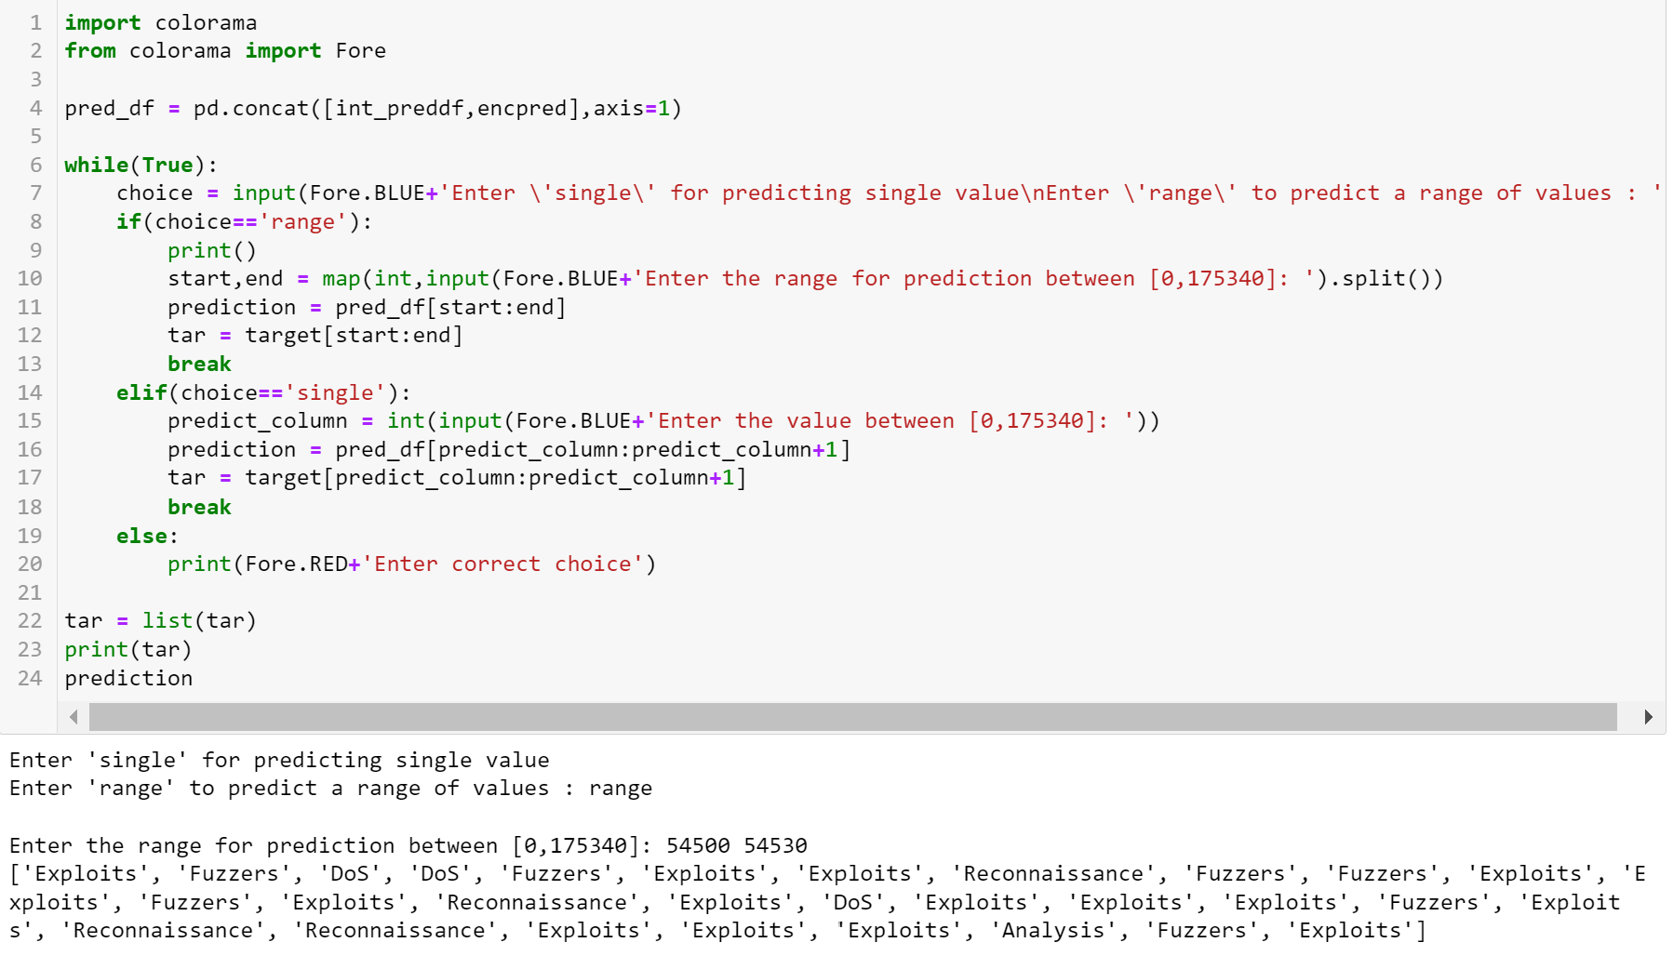
User interaction

Slide 33
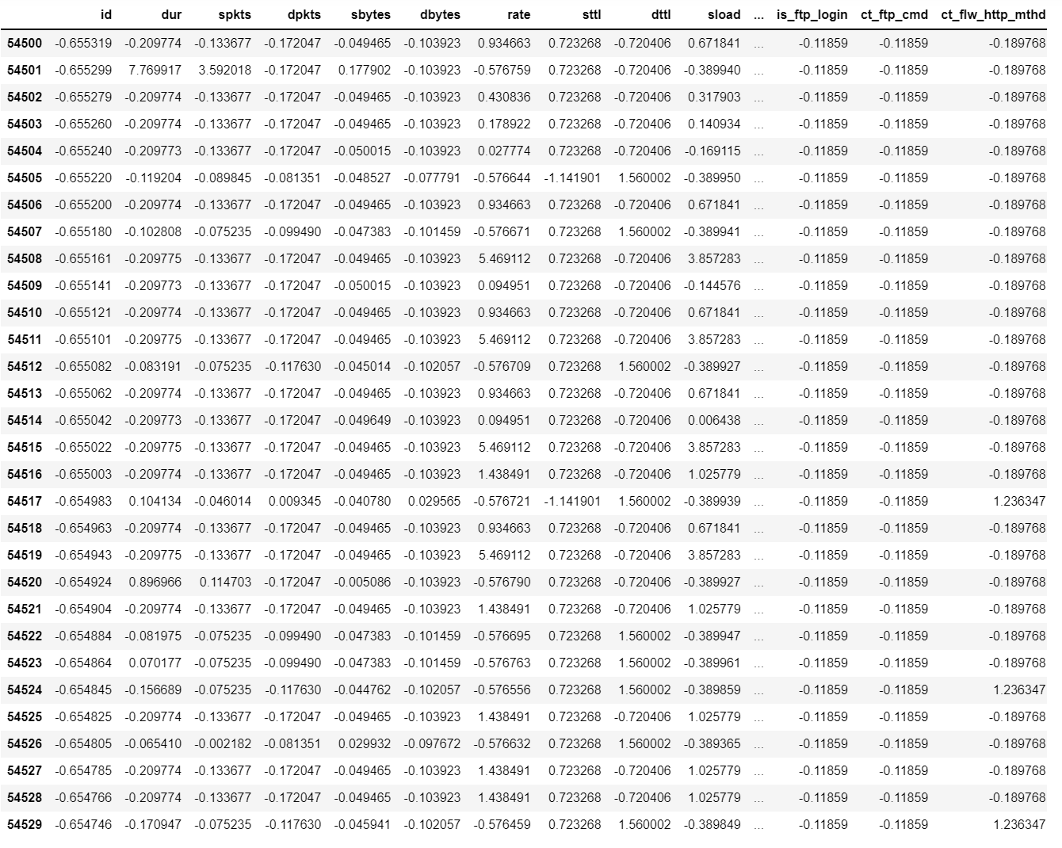
Prediction input

Slide 34
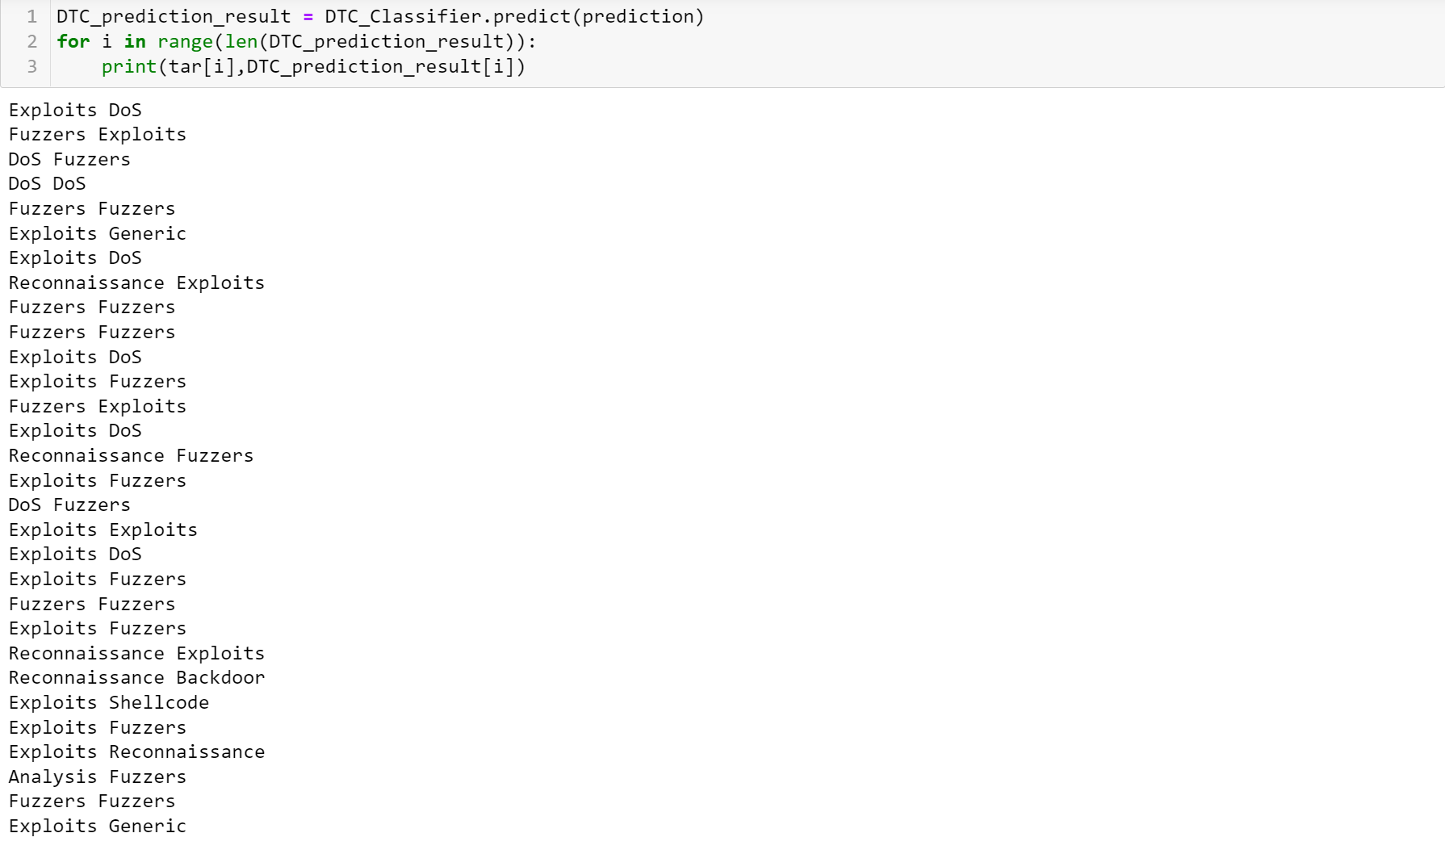
Prediction output

Slide 35
Thank you

